Slide 1
Cognos Analytics Dashboard For Sales

Slide 2
Introduction to cognos analytics dashboard:
IBM Cognos Analytics is an AI-fueled business intelligence platform that supports the entire analytics cycle, from discovery to implementation.
IBM Cognos Analytics is a self-service analytic platform that integrates cognitive computing technology, including artificial intelligence (AI) and machine learning, originally developed for Watson Analytics. For example, the platform uses cognitive technologies to help automate data preparation

Slide 3
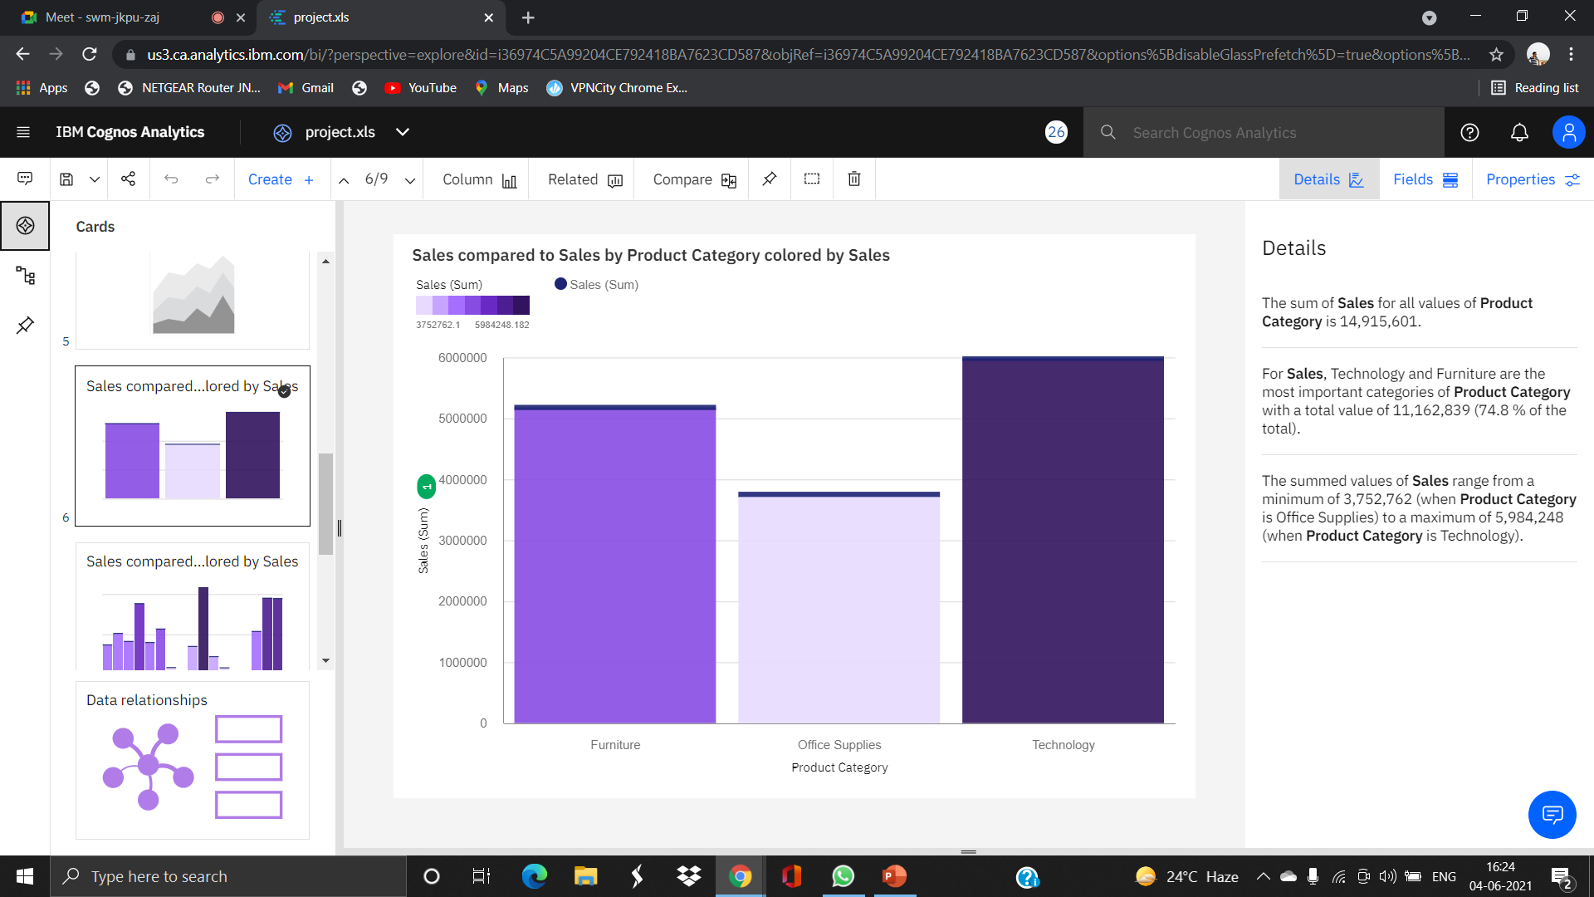
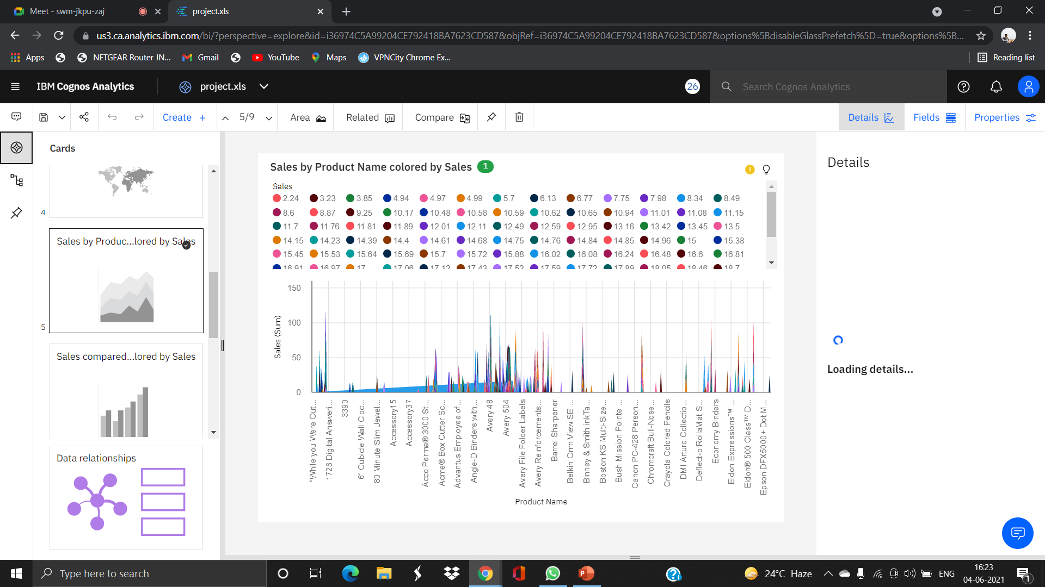
Exploration on cognos analytics

Slide 4
A flexible workspace where users can explore their data, or explore existing asset in a Dashboard or a story
Low barrier to entry:make it easy for any user to get started exploring
Surface advanced analystics insight subtle way
Provide contextual recommendation
While we can share an exploration, it is not intended to be means of presentation

Slide 5
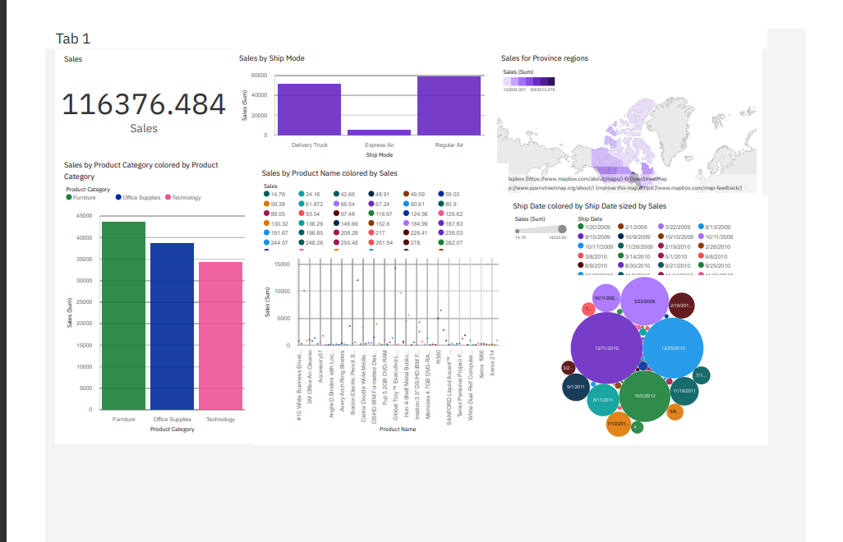
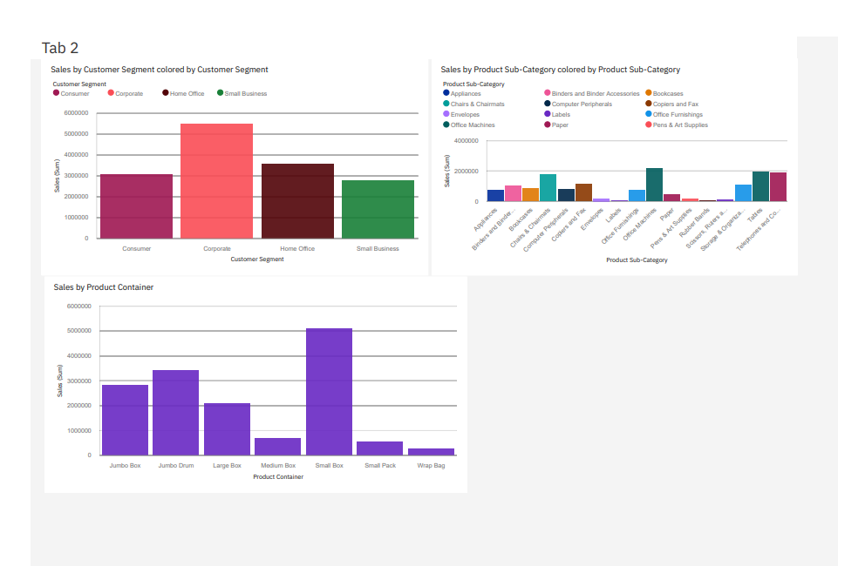
Cognos analytics dashboard

Slide 6
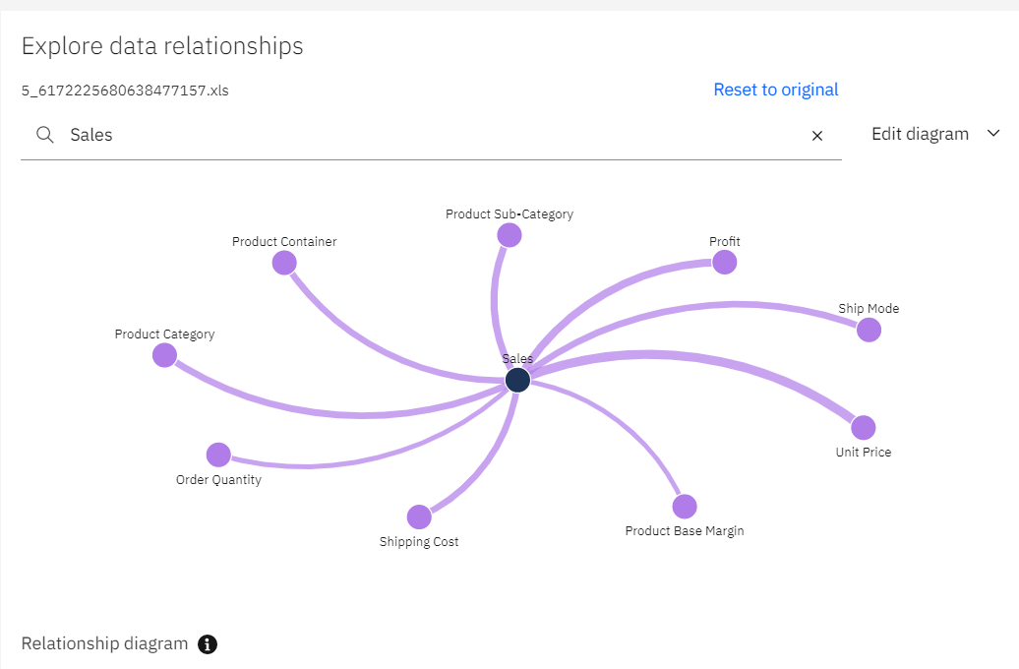
In this Dashboard we are considering sales as the target element and we have explored sales with other features effecting sales
Sales with Ship mode
Sales by Province region
Sales by Product category
Sales by Product name
Sales by Ship date
Sales by Product sub-category
Sales by Customer segment
Sales by product container

Slide 7

IT Team -11
Yagna Sri Thirupathi
V Seeyon Kumari
V Yashwanth Nag

